Slide 1

Advancing Organic Photovoltaics with Infrastructure for Transferable, Reproducible, Useable, and Extensible (TRUE) Multiscale Models
September 22, 2020
Jenny W. Fothergill

Slide 2
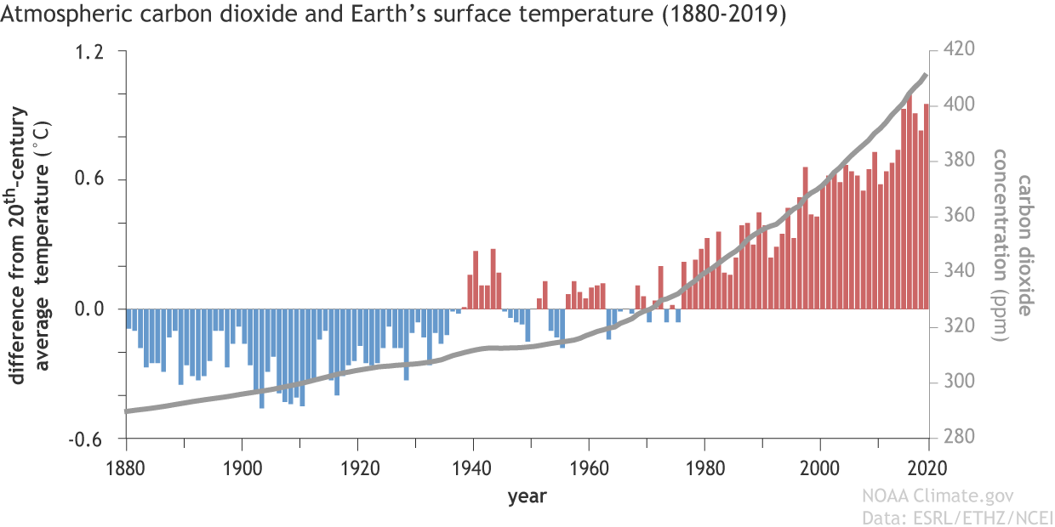
Global temperature rise is linked to atmospheric CO₂
Notes:
https://www.climate.gov/news-features/climate-qa/if-carbon-dioxide-hits-new-high-every-year-why-isn%E2%80%99t-every-year-hotter-last

Slide 3
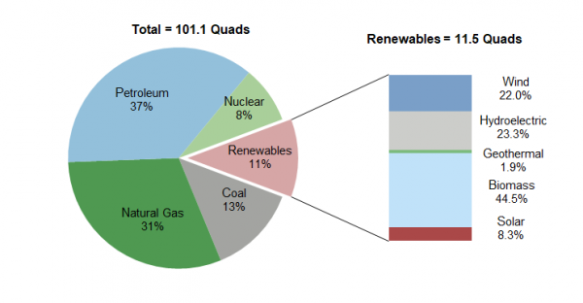
Solar accounts for less than 1% of US energy
Notes:
http://css.umich.edu/factsheets/us-renewable-energy-factsheet

Slide 4
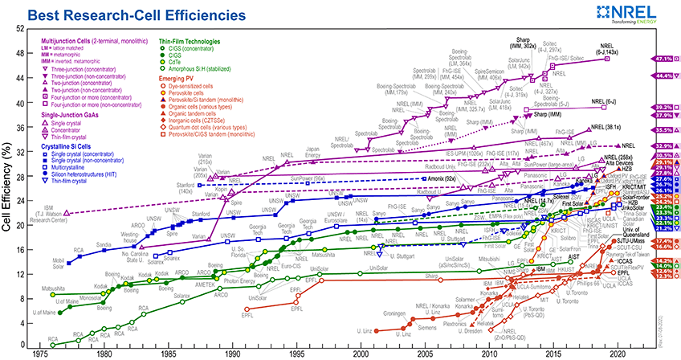
OPVs have potential to improve

Slide 5
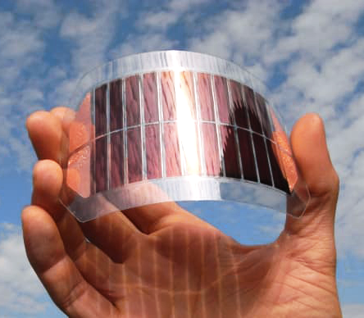
OPV production is
large scale and cheap
Notes:
https://solenergy.com.ph/the-rise-of-organic-photovoltaics/
Dou2013

Slide 6
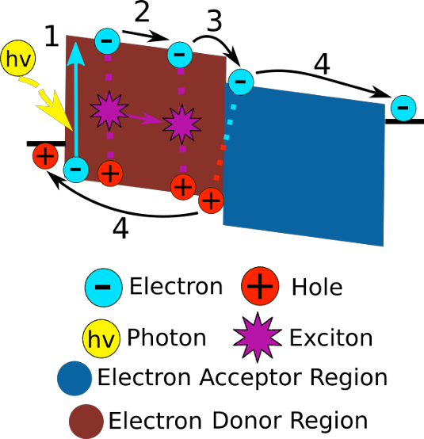

OPV efficiency is strongly linked to structure

Slide 7
Welcome to the “ZOO”

Slide 8
Choose chemistry
Create coarse-grain model
Obtain coarse-grain morphology
Backmap to retrieve atomic information
Calculate charge transport and diffraction

Slide 9

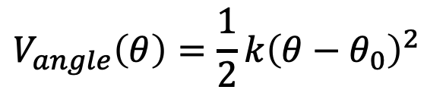
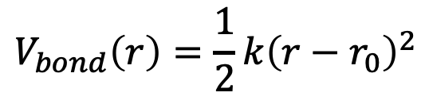
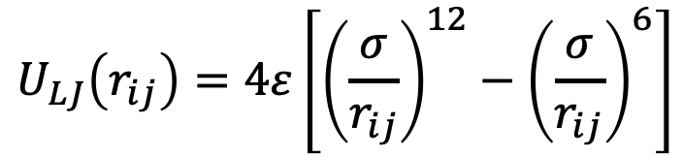
Molecular Dynamics
$$U_{LJ}\left(r_{ij}\right)=4ε\left[{\left(\frac{σ}{r_{ij}}\right)}^{12}−{\left(\frac{σ}{r_{ij}}\right)}^{6}\right]$$
$$V_{bond}\left(r\right)=\frac{1}{2}k{\left(r−r_{0}\right)}^{2}$$
$$V_{angle}\left(θ\right)=\frac{1}{2}k{\left(θ−θ_{0}\right)}^{2}$$
$$V_{dihedral}\left(φ\right)=\frac{1}{2}k_{1}\left(1−\cos{(φ)}⁡\right)+\frac{1}{2}k_{2}\left(1−\cos{(2φ)}⁡\right)+\frac{1}{2}k_{3}\left(1−\cos{(3φ)}⁡\right)+{\frac{1}{2}k}_{4}\left(1−\cos{(4φ)}⁡\right)$$

Slide 10
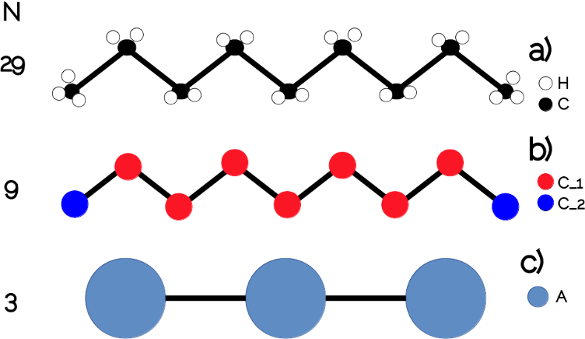
Coarse Graining

Slide 11
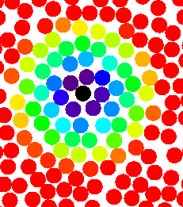
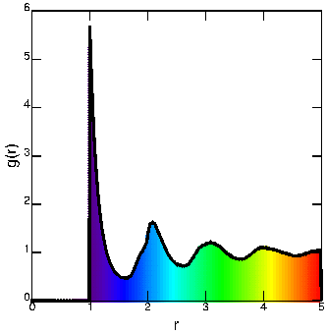
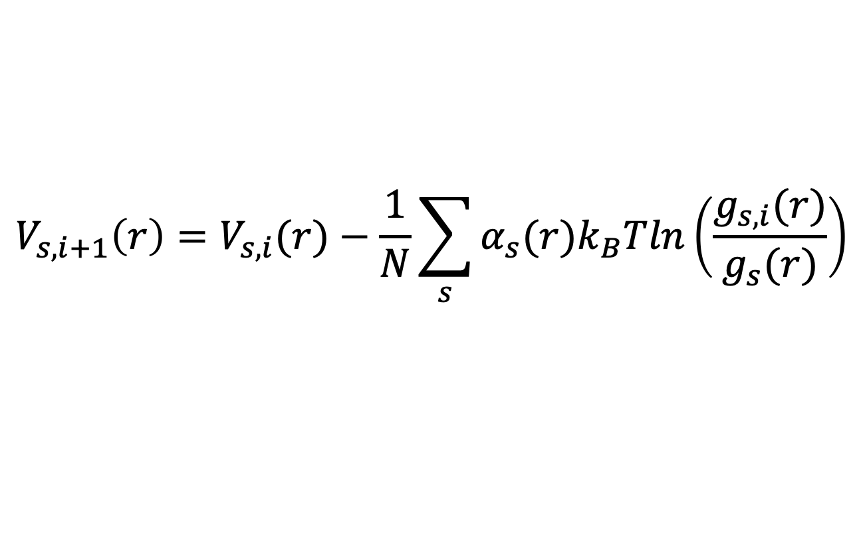
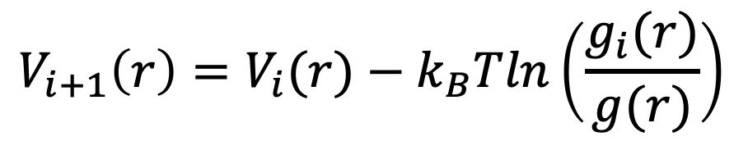
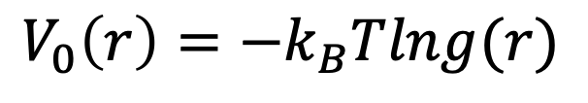
Iterative Boltzmann Inversion
$$V_{0}\left(r\right)=−k_{B}Tlng(r)$$
$$V_{i+1}\left(r\right)=V_{i}(r)−k_{B}Tln\left(\frac{g_{i}(r)}{g(r)}\right)$$
$$V_{s,i+1}\left(r\right)=V_{s,i}(r)−\frac{1}{N}\sum_{s}{α_{s}(r)k_{B}Tln\left(\frac{g_{s,i}(r)}{g_{s}(r)}\right)}$$
Notes:
http://www.physics.emory.edu/faculty/weeks/idl/gofr.html

Slide 12
Backmapping

Slide 13
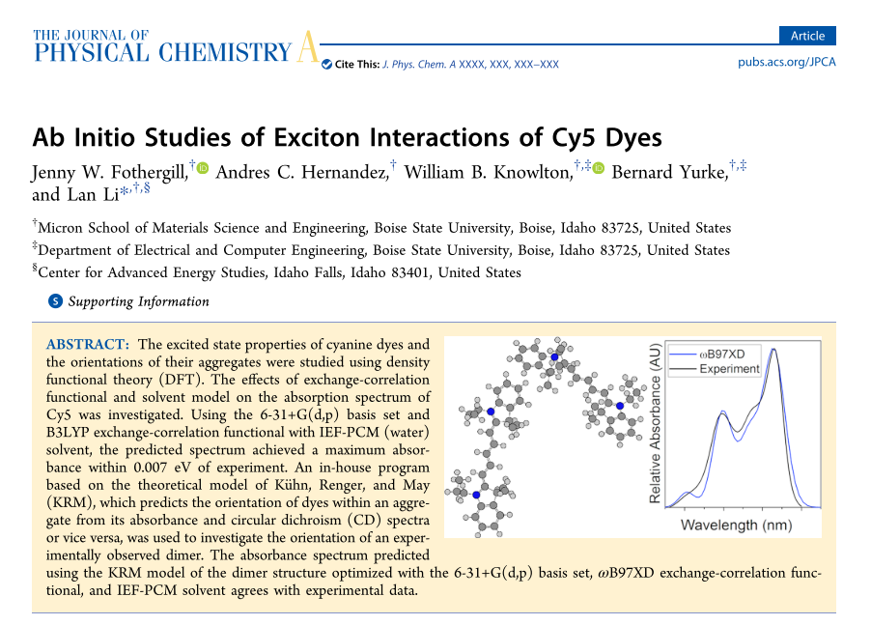
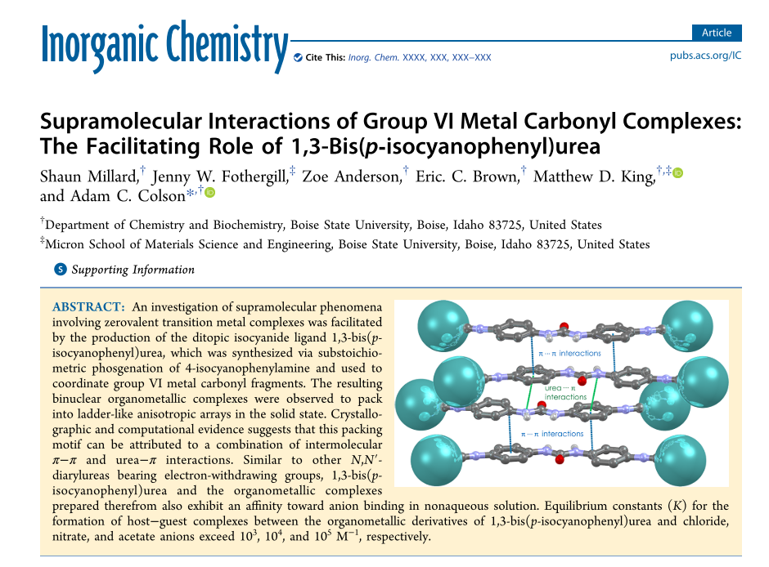
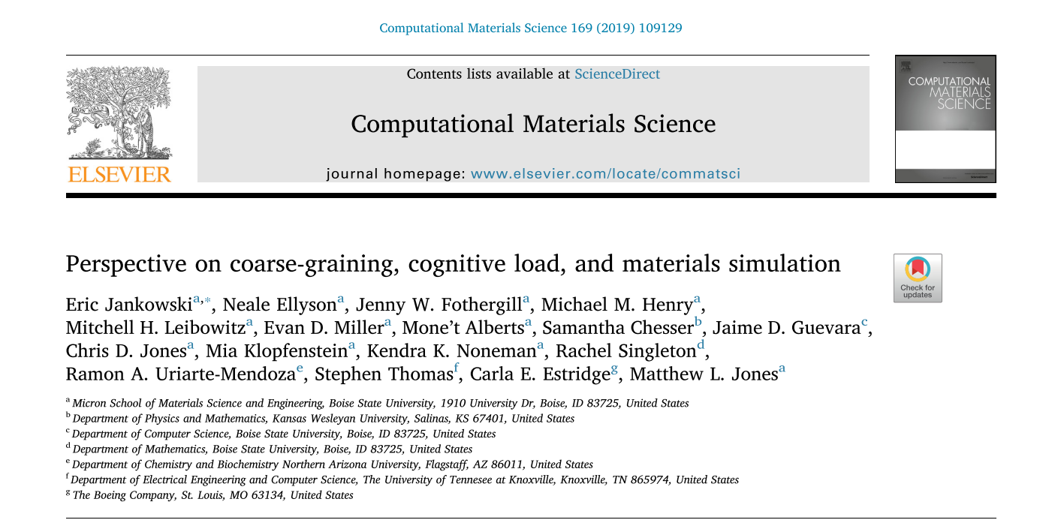

Slide 14

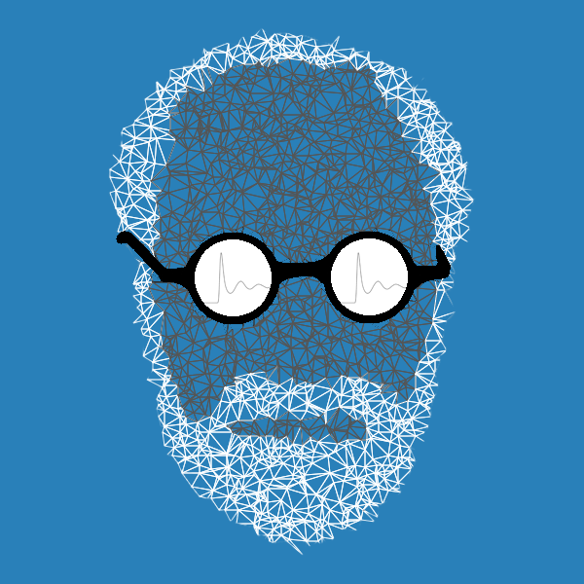

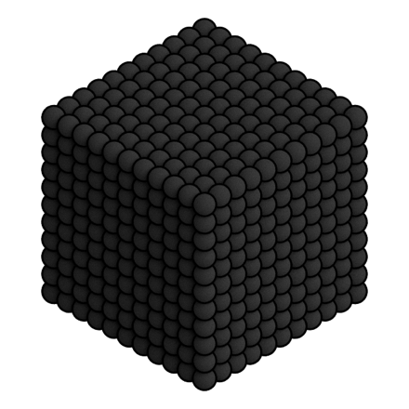

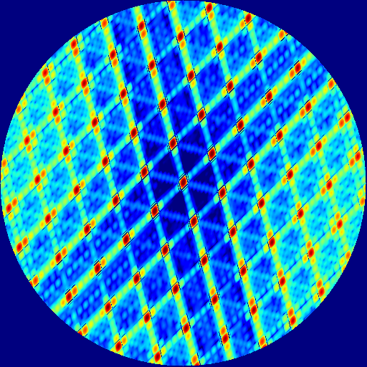

mBuild
gsd
fresnel
GIXStapose

Slide 15
Objective 1: Develop a generalized toolset for coarse-graining and performing simulations of novel molecules for organic photovoltaics
Objective 2: Develop a general tool to calculate atomistic positions from a coarse-grained morphology
Objective 3: Predict nanostructures of novel OPV chemistries
Objective 4: Identify chemical features correlated with robust self-assembly and good charge transport

Slide 16
GRiTS : Grits Reduce/Restore (i) Topology with SMILES
https://github.com/jennyfothergill/grits

Slide 17
These achieve the same result
hexane_sites = [("_A", "C[CH3]"), ("_B", "CC")]

Slide 18
this

Slide 19
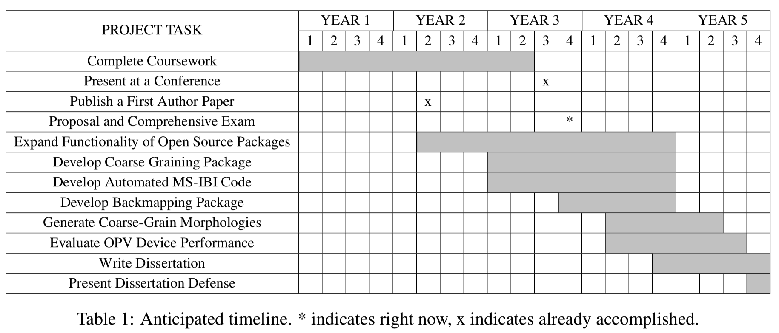
Timeline

Slide 20
this

Slide 21
Questions?

Slide 22
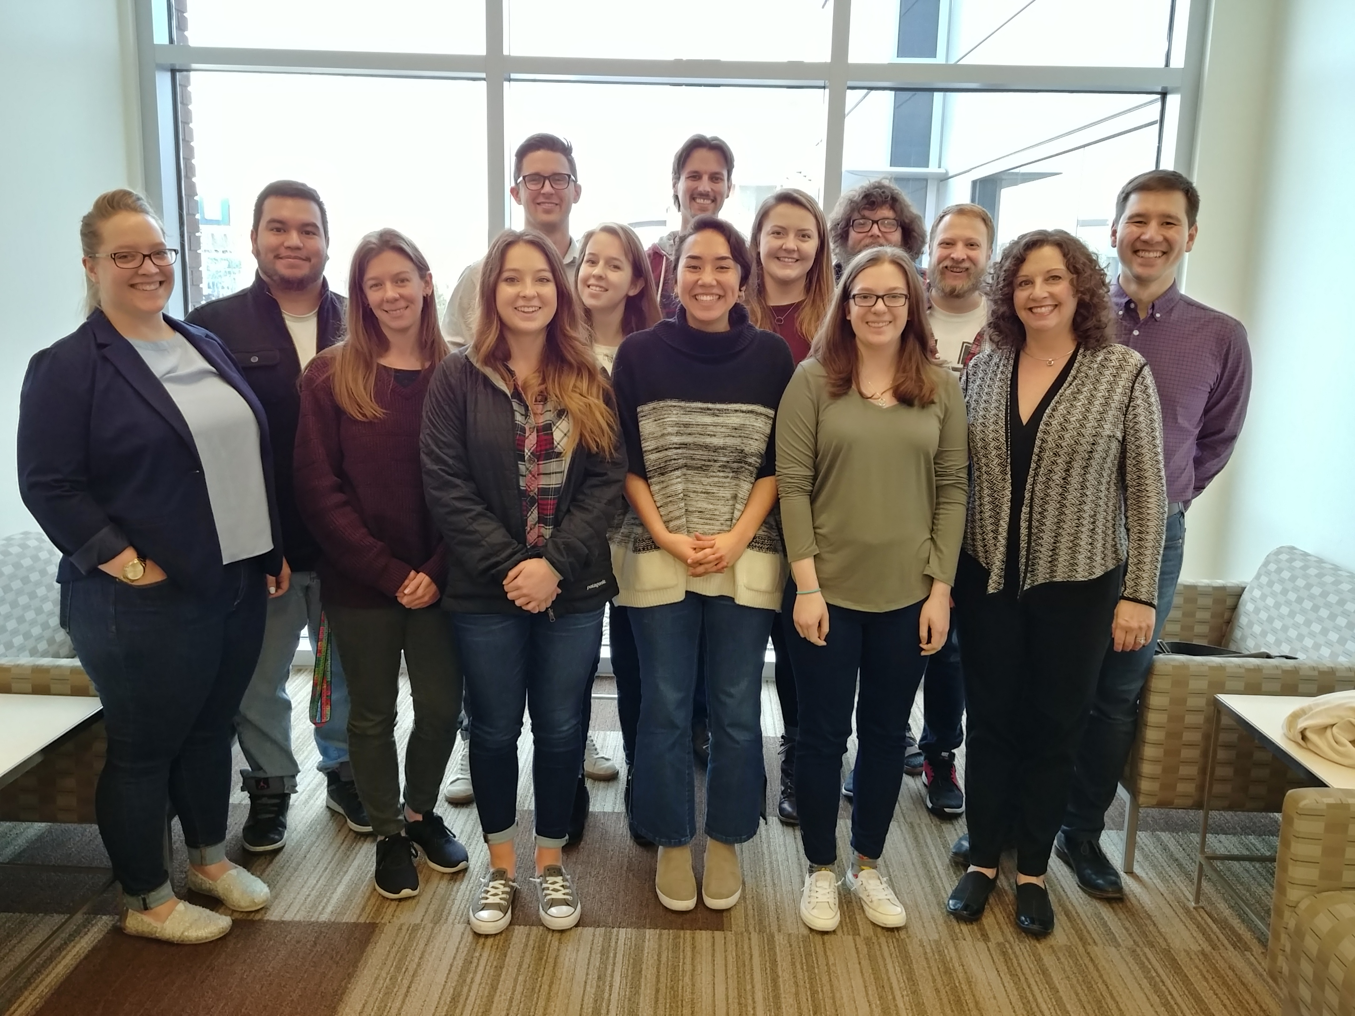
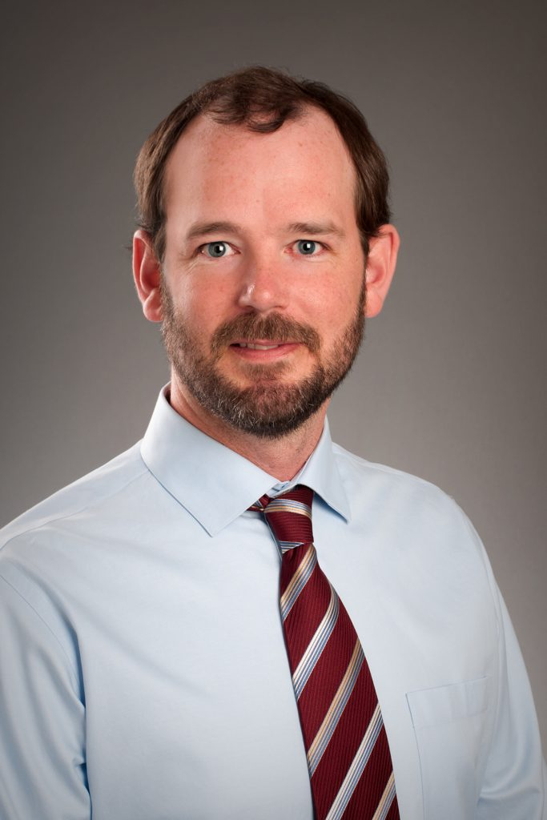
Thank YOU!

